Slide 1
VAIDS-DSML exercise block 8
Jasmin Duvivié

Slide 2
decision tree classification
problem
310 samples of vertebral columns
6 features
1 target:
Disk Hernia
Spondylolisthesis
Normal
we need to know, which feature value creates the most significant decision tree with depth 1 (stump)
solution
for each feature sort the samples by that feature
for each value, split the samples into <= and > than that value
calculate the information gain for each split
the split with the highest information gain creates the best stump

Slide 3
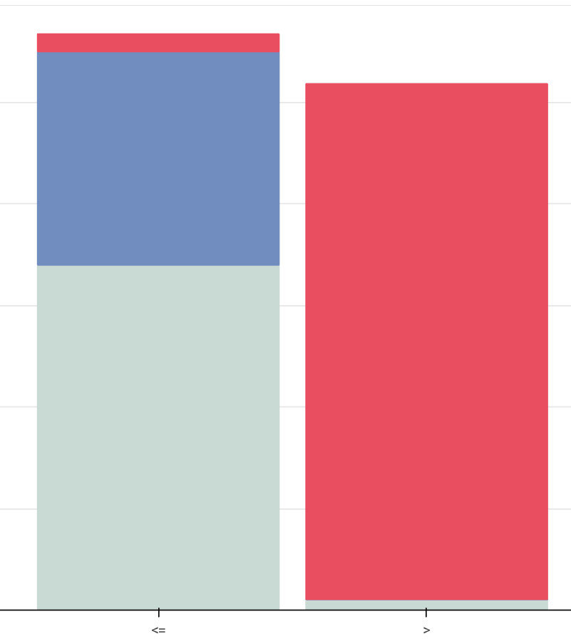
decision tree classification
feature:
degree_spondylolisthesis
value:
15.78000
information gain:
0.83380

Slide 4
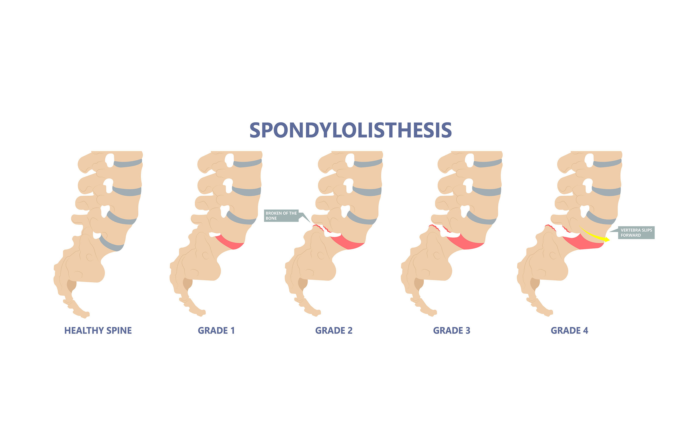
decision tree classification

